Slide 1
Distributed Systems

Slide 2
“I hear and I forget, I see and I remember, I do
and I understand” – Chinese proverb
2

Slide 3
OUTLINE
Distributed System Definitions.
Distributed Systems Examples:
  The Internet.
  Intranets.
  Mobile and Ubiquitous Computing.
Resource Sharing.
The World Wide Web.
Distributed Systems Challenges.

Slide 4
Distributed System Definitions
A system in which hardware or software components located at networked computers communicate and coordinate their actions only by message passing.
  Concurrency of components.
  No global clock.
  Independent failures.
A collection of two or more independent computers which coordinate their processing through the exchange of synchronous or asynchronous message passing.
A collection of independent computers that appear to the users of the system as a single computer.

Slide 5
Computer Networks vs. Distributed Systems
Computer Network: the independent computers are explicitly visible (can be explicitly addressed).
Distributed System: existence of multiple independent computers is transparent.
However,
  many problems in common,
  in some sense networks or parts of them (e.g., name services) are also distributed systems, and
  normally, every distributed system relies on services provided by a computer network.

Slide 6
Why Distributed Systems
Functional distribution: computers have different functional capabilities (i.e., sharing of resources with specific functionalities).
Load distribution / balancing: assign tasks to processors such that the overall system performance is optimized.
Replication of processing power: independent processors working on the same task:
  Distributed systems consisting of collections of microcomputers may have processing powers that no supercomputer will ever achieve.
Physical separation: systems that rely on the fact that computers are physically separated (e.g., to satisfy reliability requirements).
Economics: collections of microprocessors offer a better price/performance ration than large mainframes.
  mainframes: 10 times faster, 1000 times as expensive

Slide 7
Distributed Systems Examples
(The Internet)
The Internet is a vast interconnected collection of computer networks of many types.
Its design enabling a program running anywhere to address messages to programs anywhere else.
Allowing its users to make use of many services as: WWW, E-Mail, Web hosting, and File transfer.
Its services can be extended by adding new types of service (open-ended services).
Small organizations and individual users can to access internet services through Internet Service Providers (ISPs).
Independent intranets are linked together by high transmission capacity circuits called backbones.

Slide 8
Distributed Systems Examples
(The Internet)
intranet

ISP



backbone
satellite link
desktop computer:
server:
network link:
A typical portion of the Internet

Slide 9
Distributed Systems Examples
(Intranets)
An Intranet is a portion of the internet that is administrated separately and its local security policies are enforced by a configured boundary.
Composed of several local area networks (LANs) linked by backbone connections to allow its users to access the provided services.
Connected to the Internet via a router which allows its users to make use of the internet services elsewhere.
Many organization protect their own services from unauthorized use by filtering incoming and outgoing messages using a firewall.

Slide 10
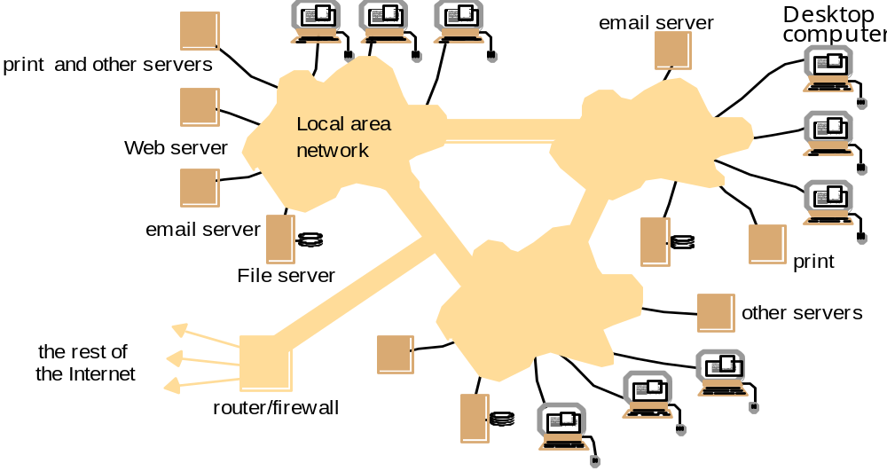
Distributed Systems Examples
(Intranets)
A typical Intranet

Slide 11
Distributed Systems Examples
(Mobile and Ubiquitous Computing)
The portability of many computing devices and the ability to connect to networks in different places makes mobile computing possible.
Mobile computing is the performance of computing tasks while the users are on the move and away from their residence intranet but still provided with access to resources via the devices they carry with them.
Ubiquitous computing is the harnessing of many small cheap computational devices that are present in user’s physical environments.

Slide 12
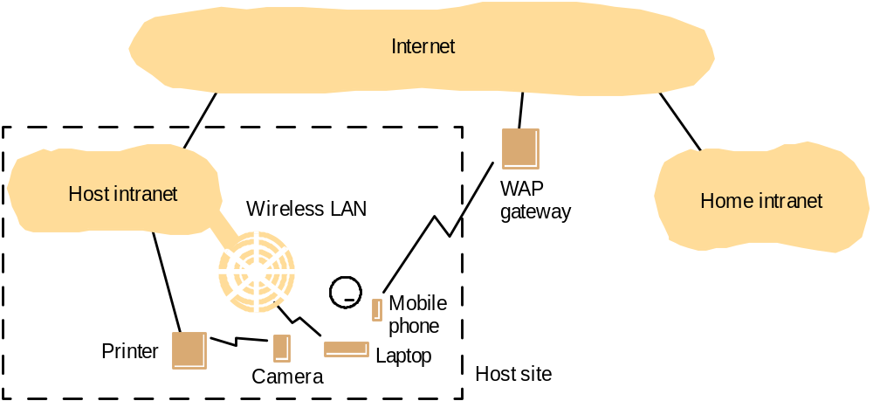
Distributed Systems Examples
(Mobile and Ubiquitous Computing)
Portable and handheld devices in a distributed system

Slide 13
Resource Sharing
Resources in a distributed system are:
  Encapsulated within computers.
  Can only accessed from other computers by communication.
  Managed by a program that offers a communication interface.
The term service is used for a distinct part of a computer system which manages a collection of related resources and presents their functionality to users and applications via a well-defined set of operations.
Server refers to a running program on a networked computer that accepts request messages from programs, clients, running on other computers to perform a service and responds appropriately by reply messages.
A complete interaction between a client and a server is called a remote invocation.

Slide 14
The World Wide Web (WWW)
An executing web browser is an example of a client communicates with a web server to request web pages from it.
WWW is an open client-server architecture implemented on top of the Internet.
Users use the Web through available web browsers to retrieve and view documents of many types and interact with unlimited set of services.
Web provides a hypertext structure among the documents that it stores. (i.e., the documents contain references, links, to other related documents and resources stored also in the web).

Slide 15
The World Wide Web (WWW)
http://www.google.com/search?q=kindberg
www.google.com
Web servers
Browsers
www.cdk3.net
Internet
http://www.cdk3.net/
www.w3c.org
File system of
http://www.w3c.org/Protocols/Activity.html
www.w3c.org
Protocols
Activity.html
Web servers and web browsers

Slide 16
The World Wide Web (WWW)
Web is an open system and can be extended and implemented in new ways without disturbing its existing functionality.
  Its operation is based on communication standards and document standards that are freely published and widely implemented.
  Types of resources that can be published and shared on it is open (plug-ins handle new document formats without changing the web browser).
Web is based on three main standard technological components:
  The HyperText Markup Language (HTML) specifies the contents and layout of pages as they are displayed by web browser.
  Uniform Resource Locators (URLs) identify documents and other resources accessible via the web.
  The HyperText Transfer Protocol (HTTP) determines the standard rules for interaction between browsers and web servers to fetch documents and other resources.

Slide 17
Distributed Systems Challenges
A number of challenges are recognized in the design of distributed systems.
These challenges have been tackled with varying degrees of success in existing systems.
The list below gives some indication of measures that are employed to meet each challenge:
  Heterogeneity: standards and protocols; middleware; virtual machine;
  Openness: publication of services; notification of interfaces;
  Security: firewalls; encryption;
  Scalability: replication; caching; multiple servers;
  Failure Handling: failure tolerance; recover/roll-back; redundancy;
  Concurrency: concurrency control to ensure data consistency;
  Transparency: middleware; location transparent naming;

